Slide 1
Google Cloud Platform
Aug, 2018
Namutech
Youngtaek.an@namutech.co.kr
Notes:
Bringing Google’s DNA in running, scaling, and growing our business into a different kind of partnering model for you.

Slide 2
Agenda
Executive Summary
Google Cloud
Network
Big Data
Machine Learning
Devops & Agile
Pricing
Support
Security

Slide 3
Executive summary
빅데이터 및 머신러닝 : Industry-leading 데이타 분석 및 머신러닝 기술
매니지드 서비스 : 1억 다운로드 21M 일 방문자 서비스 → 1인 개발 및 운영
가격 : 경쟁사 대비 평균 60% 저렴한 금액으로 높은 성능의 클라우드를 제공
성능 : 글로벌 네트워크 가속망을 이용, 별도의 비용 없이 전세계 사용자를 대상으로 빠른 서비스 제공
락인 회피 : 오픈소스 기반으로 벤더 Lock in 최소화 (쿠버네티스)
엔지니어 서포트 : 오픈소스 / 구글 제품 개발팀과 엔지니어 협업. 구글 운영 노하우 전수 (SRE)
항목 | 상세 | 비고
빅데이타 머신러닝 | 클라우드 스케일 연산 ( 10억레코드/4TB 연산시 - 24초 소요/20$ VS 스파크 100대 3시간) TPU 7x 빠름 NVIDIA P100 GPU 구글과 고객이 협업하여, 구글 본사에서 고객사 엔지니어와 공동으로 머신러닝 모델 개발 가능
가격 | 평균 타사 대비 60% 저렴, 분당 과금, VM 사용량을 합쳐서 할인 (SUD), 80% 할인된 PVM CPU와 Mem 사이즈 설정 가능한 Custom type
성능 | 내부망 최대 16GB 대역폭 (별도 과금 없음) 전세계 33개국, 120+개의 엣지 서버를 이용한 망 가속 기능 제공 (별도 과금 없음)
벤더 락인 | 오픈소스 호환 (Apache Beam, Kubernetes, Tensorflow 등)으로 락인에서 상대적으로 자유로움
엔지니어 서포트 | 제품 개발팀, 오픈소스 개발팀 엔지니어와 소통을 통한 기술 지원 구글 운영 SRE에 대한 노하우 전수

Slide 4
Google Cloud
01

Slide 5
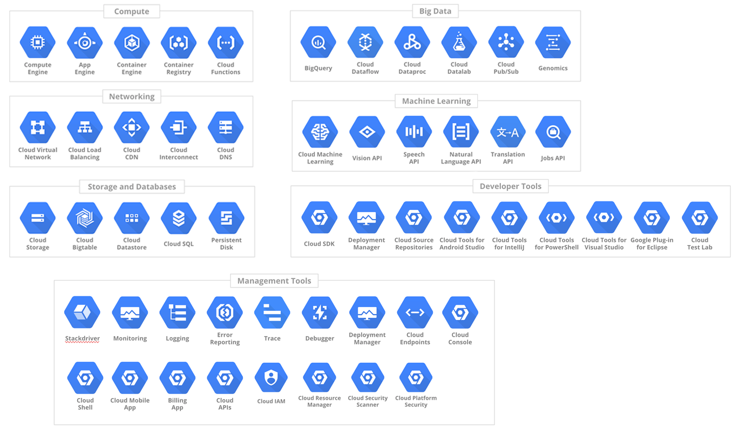

Slide 6
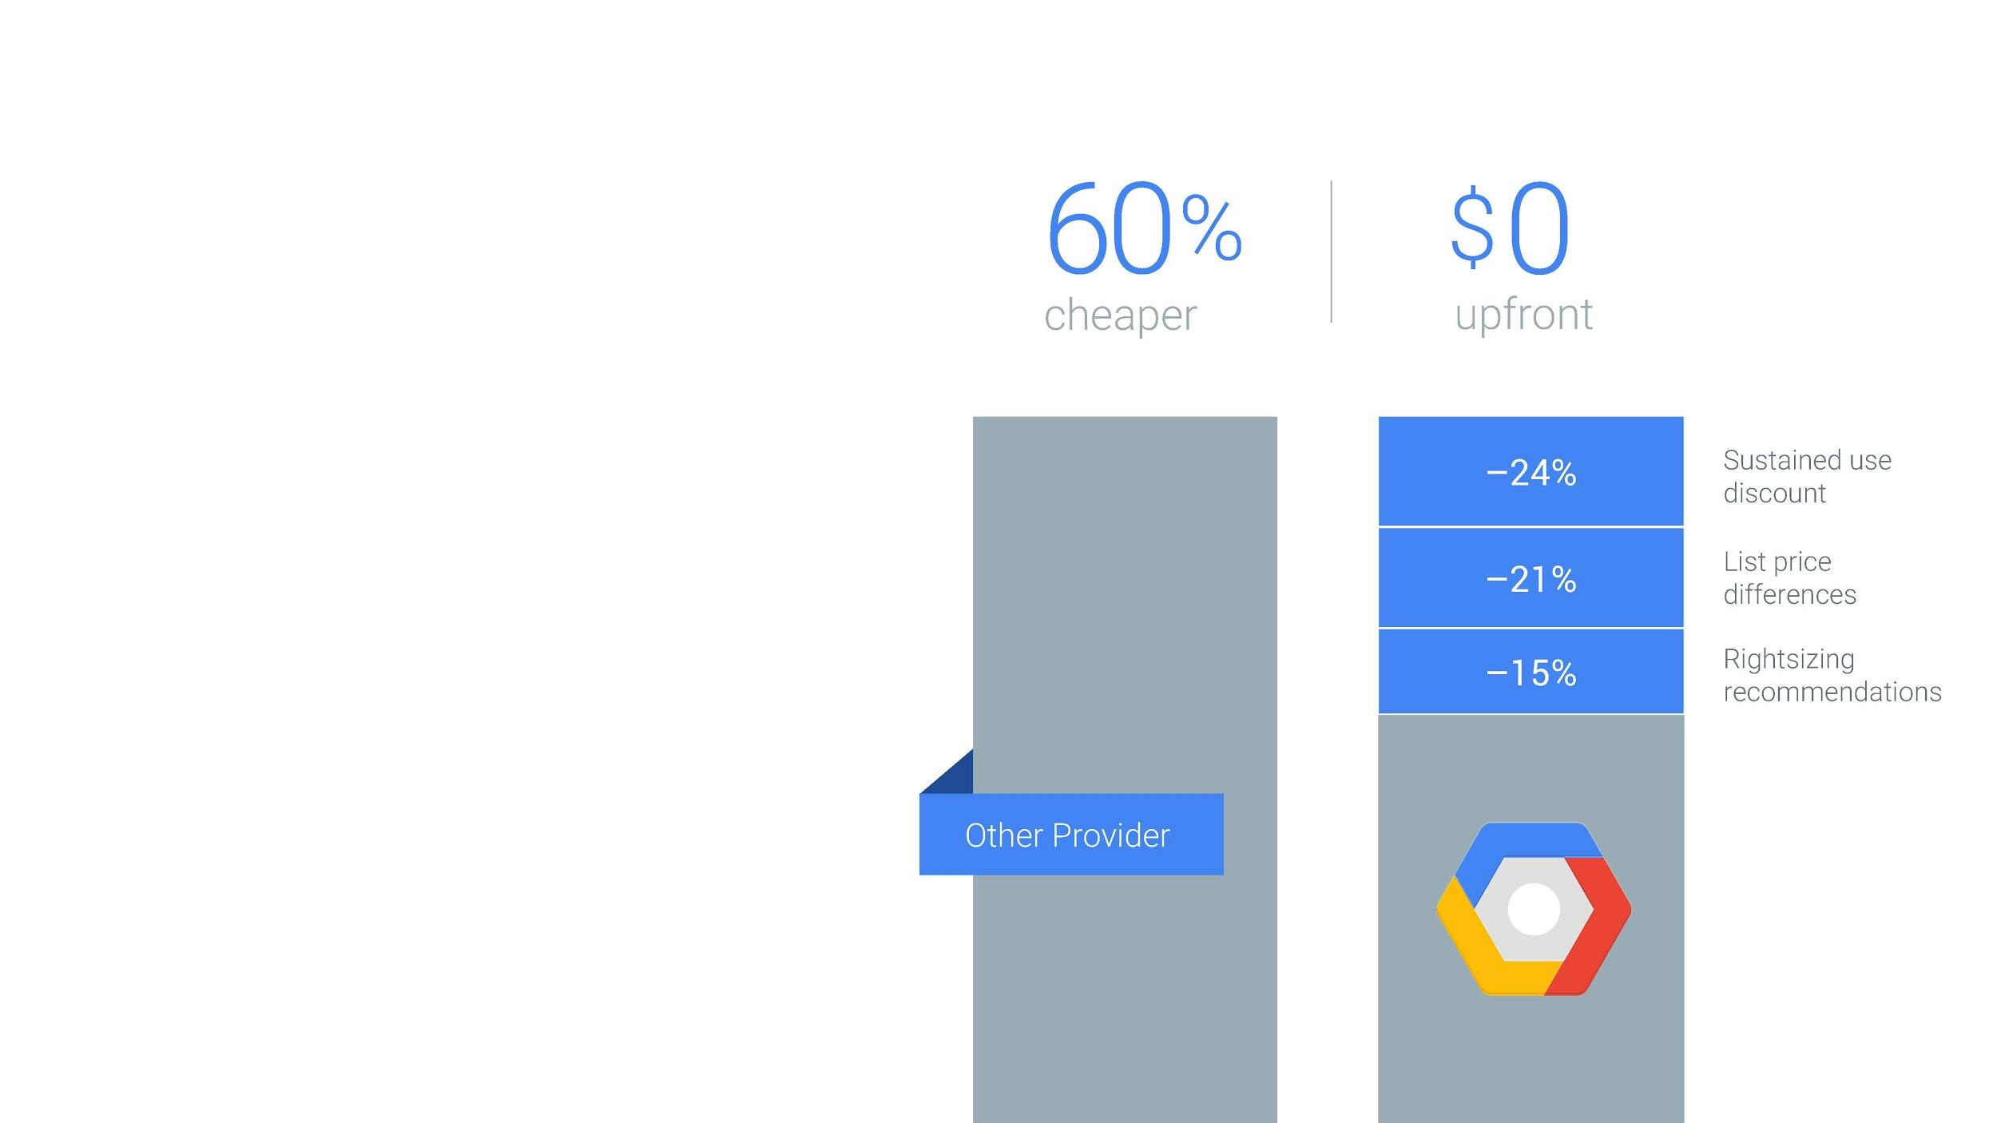
Virtual Machine
Cost
Innovative Pricing Models
Customer Reliability Engineering - partnership of shared authority and responsibility for reliability
Engineer-to-Engineer Support - Predictable flexible, simple, role-based fees

Slide 7
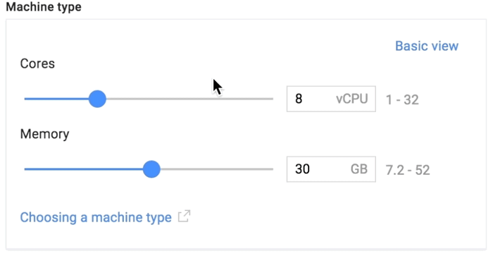
Virtual Machine
Cost
Reduce cost with customized instance type

Slide 8
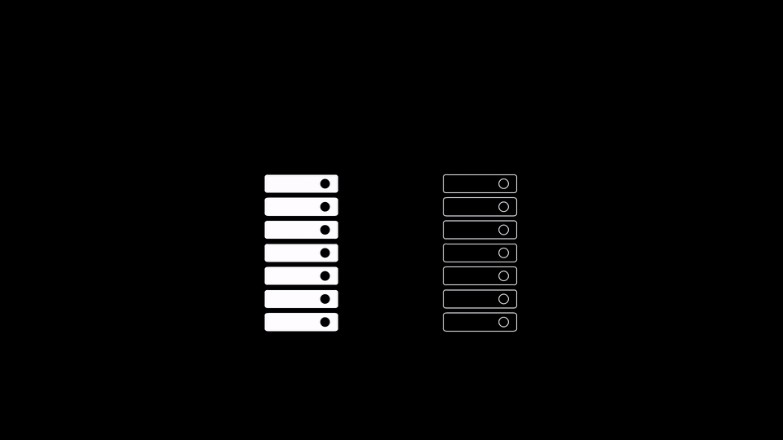
Virtual Machine
Live migration
서버 점검시 무정지 상태로 다른 물리머신으로 이동 시킨후 점검
정기점검으로 인한 다운 타임이 없음 (업계 최소 다운 타임)

Slide 9

클라우드 정전
Total time lost (minutes)
주요 클라우드 벤더간 비교
By Kevin McLaughlin and Mike Sullivan
Mar. 07, 2017 7:02 AM PST
700
600
500
400
300
200
100
0
2016
2017
Amazon
Microsoft
Google
Source: Cloud Harmony

Slide 10
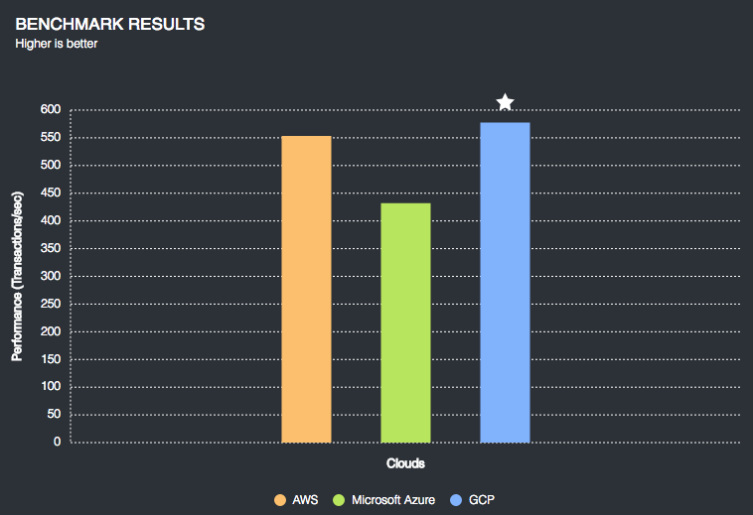
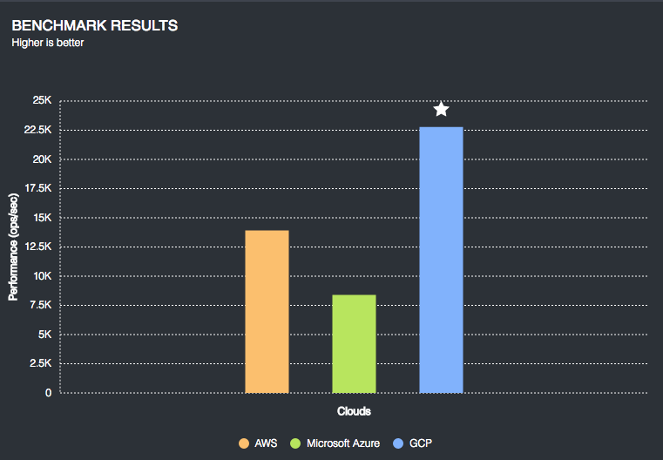
Virtual Machine
Performance (general performance)
Reduce cost with customized instance type
Sysbench OLTP performance
Mongodb ycbs
Source : https://www.cloudbenchmark.com/details/sysbench_oltp
Source : https://www.cloudbenchmark.com/details/mongodb_ycsb

Slide 11
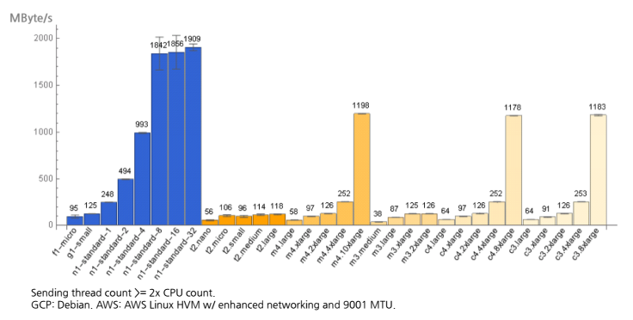
Virtual Machine
Performance (network)
VM to VM network performance comparison
GCE provides max 16GB internal network bandwidth without additional cost

Slide 12
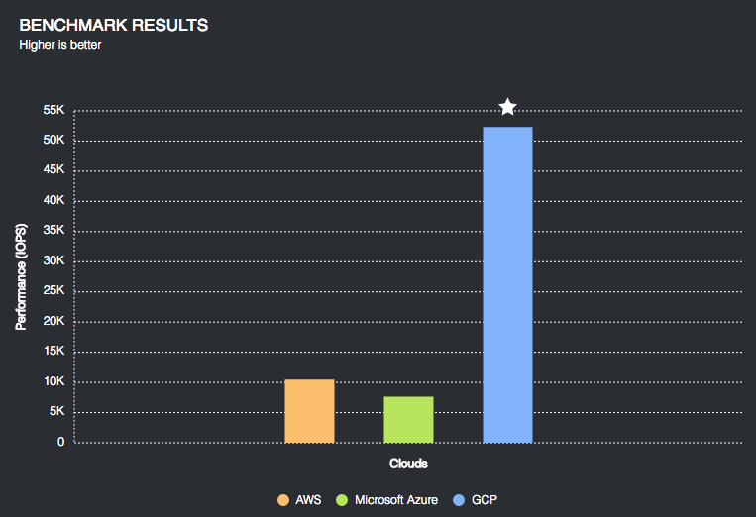
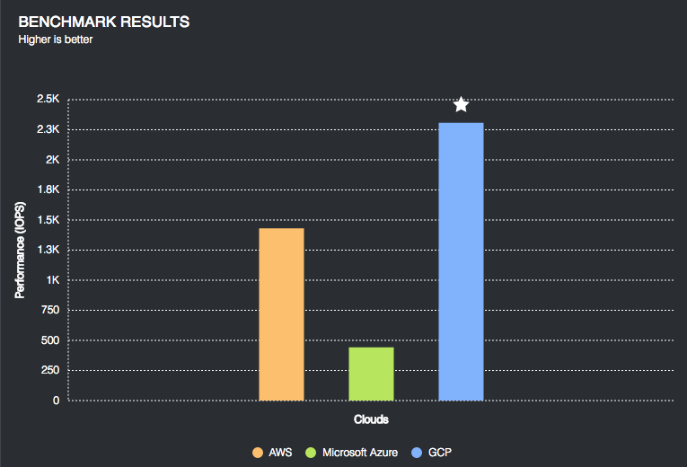
Virtual Machine
Performance (disk io)
IOPS performance comparison
You don’t have to pay additional cost for additional IOPS
DISK Read IOPS comparison
DISK Write IOPS comparison
https://www.cloudbenchmark.com/details/fio
https://www.cloudbenchmark.com/details/fio

Slide 13

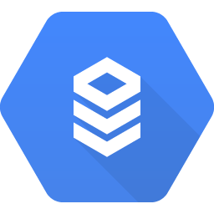
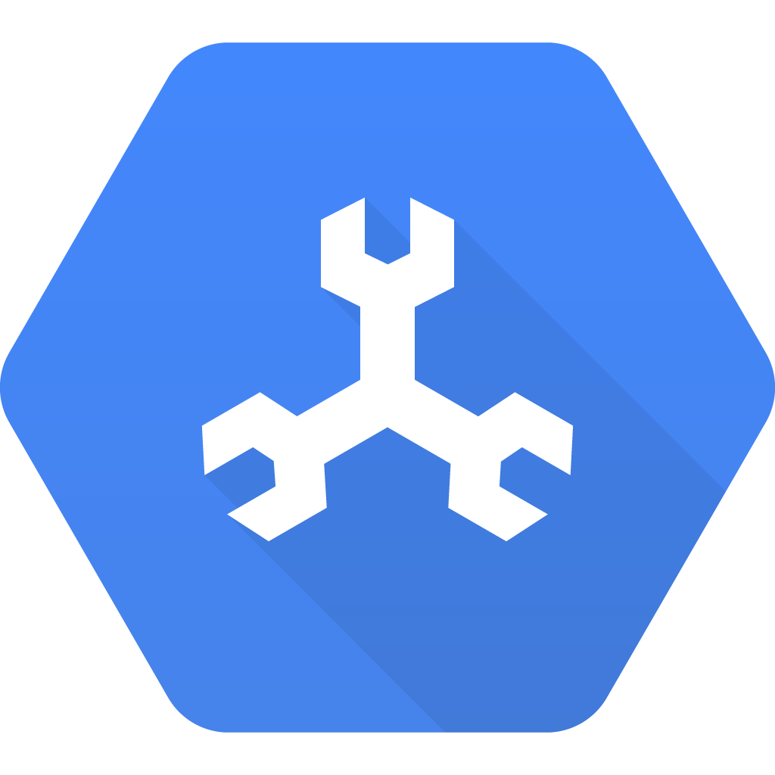
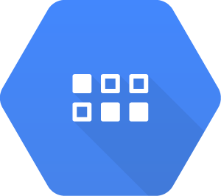
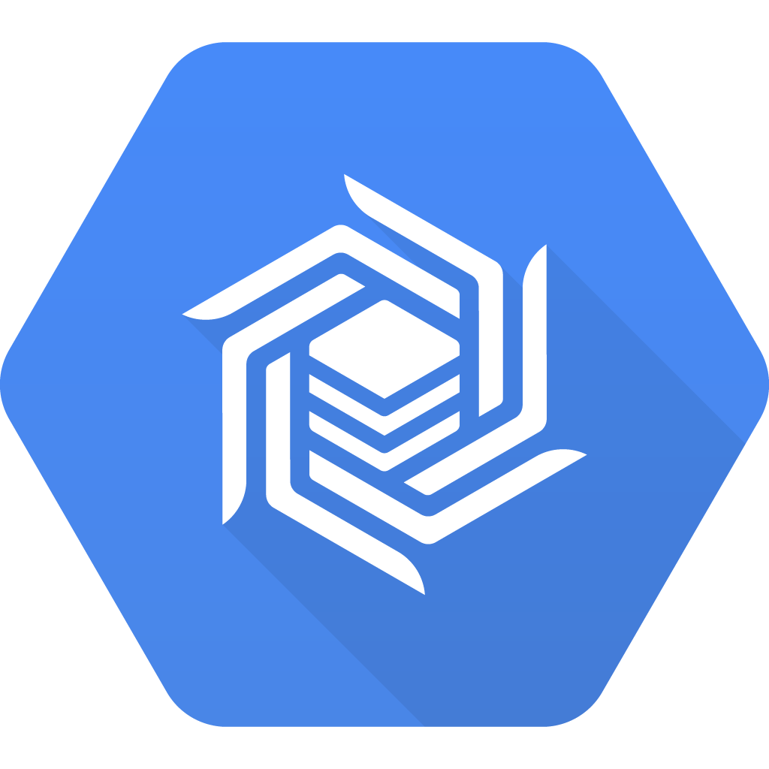
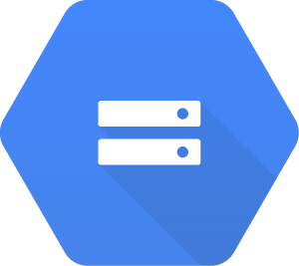

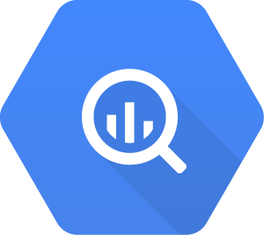
데이타 베이스
In Memory
Relational
NoSQL
Object
Block
Warehouse
EAP
Cloud Memorystore
Cloud
SQL
Cloud Spanner
Cloud Datastore
Cloud Bigtable
Cloud Storage
Persistent Disk (GCE)
Big
Query
Good for: Web/mobile apps, gaming
Such as: Game state, user sessions
Good for: Web frameworks
Such as: CMS, eCommerce
Good for: RDBMS+scale, HA, HTAP
Such as: User metadata, Ad/Fin/MarTech
Good for: Hierarchical,mobile, web
Such as: User profiles, Game State
Good for: Heavy read + write, events,
Such as: AdTech, Financial, IoT
Good for: Binary or object data (BLOB)
Such as: Media, analytics, archive/backup
Good for: Local VM file storage
Such as: Application data/binaries
Good for: Data Warehouse
Such as: Analytics, Dashboards

Slide 14
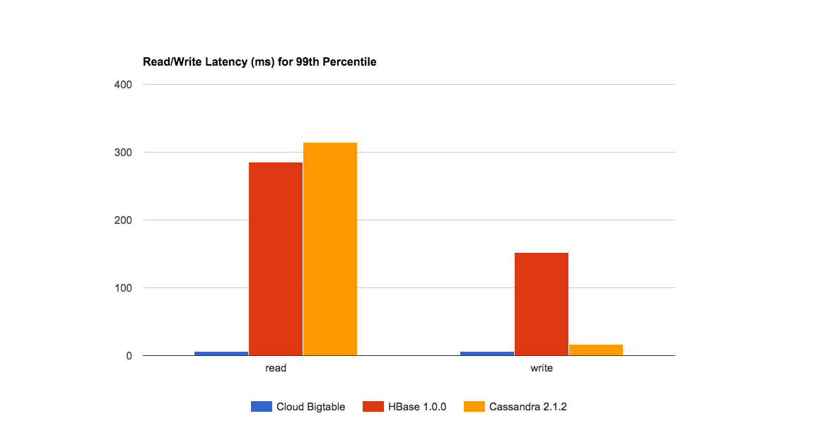
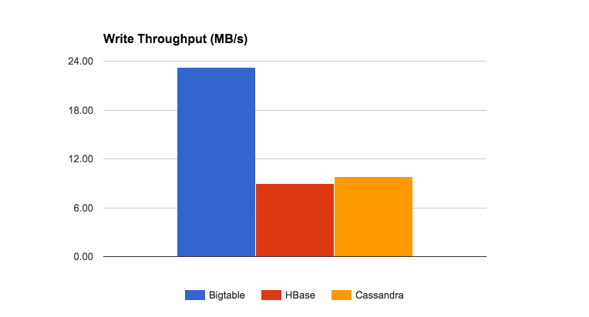
Read/Write Latency at 99% (ms)
데이타 베이스 - 구글 빅테이블
카산드라, AWS Dynamo 대응
HBase 호환 API
Column based NoSQL (cf Hbase, Cassandra)
High performance (50x faster than cassandra & hbase)
5~6 ms query time from multi PETA byte data
Linear scale
No rebalancing / resizing overload
Write Throughput (MB/s) per Dollar

Slide 15
데이타 베이스 - 구글 빅테이블
Price
Assumption : 3000 billion records, 1000 bytes per record, 1000 billion users, 1% daily active user
90% write + 10% read (Daily 900 write and 100 read per users
 | List Price | AWS 50% discount with 1Y RI. GCP No discount | AWS 50% discount with 1Y RI. GCP No discount + HA
Dynamo Total (Monthly) | 5,012,557.53 | 2506278.763 | 2506278.763
Bigtable Total (Monthly) | 583,747.45 | 583,747.45 | 1167494.903
GCP/AWS (%) | 11.65% | 23.29% | 46.58%
50% write + 50% read (Daily 500 write and 500 read per users
 | List Price | AWS 50% discount with 1Y RI. GCP No discount | AWS 50% discount with 1Y RI. GCP No discount + HA
Dynamo Total (Monthly) | 3050173.267 | 1525086.634 | 1525086.634
Bigtable Total (Monthly) | 589164.118 | 589164.118 | 1178328.236
GCP/AWS (%) | 19.32% | 38.63% | 77.26%
Notes:
Formula : https://docs.google.com/spreadsheets/d/1ay9jDWrw_exJenvkAfEha0Z9hClQVj_Bm9L7H0WOLp0/edit#gid=1186281096

Slide 16
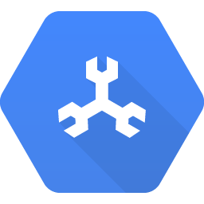
데이타 베이스 - 스패너
미션 크리티컬한 서비스를 위한 구글 클라우드의 관계형 데이타 베이스 서비스
운영이 필요없는 글로벌 스케일의 데이타 베이스 서비스
전통적인 RDBMS 의 특징을 그대로 지원: schemas,
ACID transactions, SQL
자동 동기화와, 리전 레벨의 HA를 지원
구글 내부에서 5년이상 사용중인 검증된 서비스 (Adwords, GooglePlay, ...)
Notes:
Formula : https://docs.google.com/spreadsheets/d/1ay9jDWrw_exJenvkAfEha0Z9hClQVj_Bm9L7H0WOLp0/edit#gid=1186281096

Slide 17
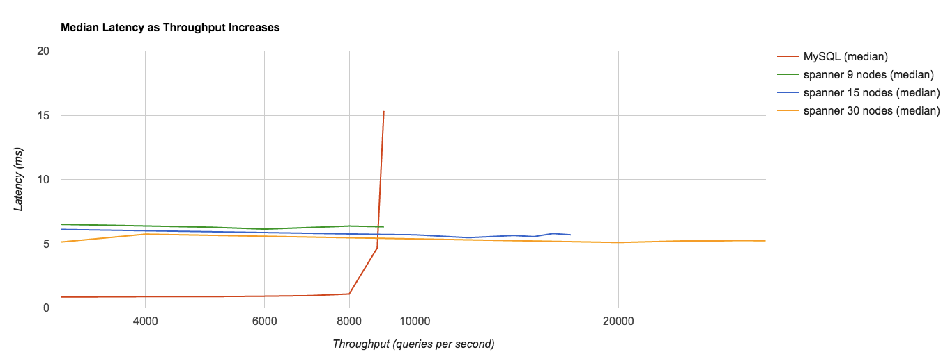
데이타 베이스 - 스패너
Comparison of median values of latency
MySQL: high-memory 64-core GCE instance running Percona MySQL 5.7 using a pd-ssd disk. This machine type has 416 GiB of memory and we've tuned the InnoDB buffer pool to 340 GiB. All disks on GCE are mounted remotely.
Source: https://quizlet.com/blog/quizlet-cloud-spanner
Notes:
Formula : https://docs.google.com/spreadsheets/d/1ay9jDWrw_exJenvkAfEha0Z9hClQVj_Bm9L7H0WOLp0/edit#gid=1186281096

Slide 18
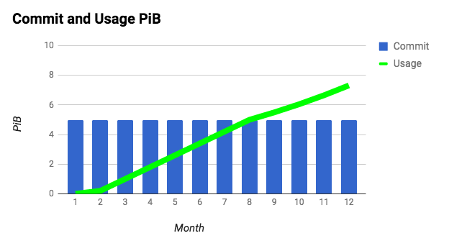
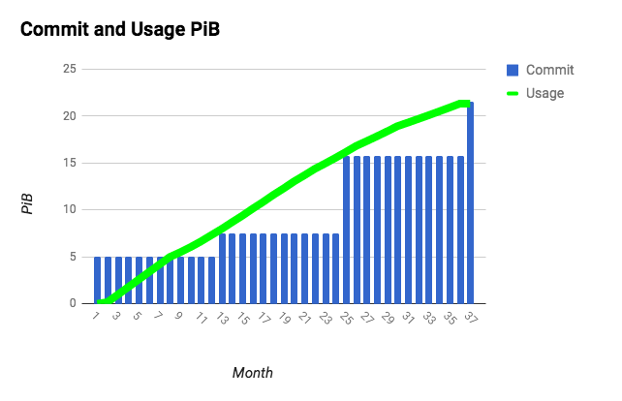
스토리지
Storage growth plan
1 year commitment based contract. No charge for overage.
It can update commitment based on last year usage
Same $$ every month
No charge for overage

Slide 19
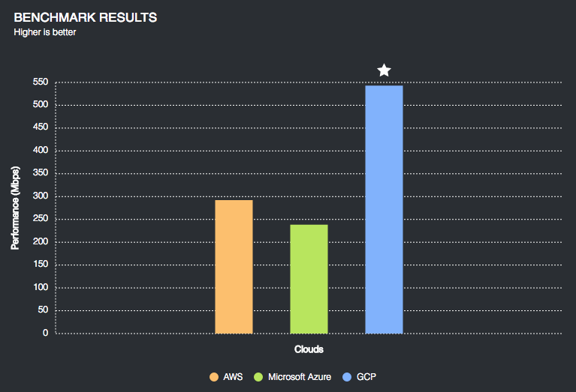
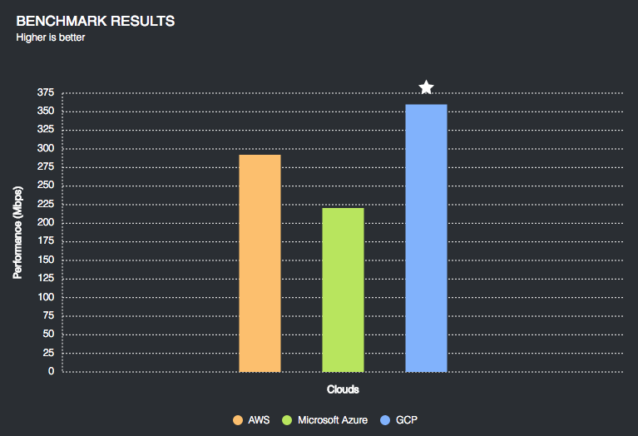
스토리지
Performance
2x Faster throughput for larger datasets (like image)
Download performance
Upload performance
Security
Encryption at rest and in motion within google cloud by default (it can use customer-supplied encryption key) (Other cloud provider require 3’rd party encryption service or manually enabling of the service)
Source : https://www.cloudbenchmark.com/details/object_storage_service
Y Axis is performance (Mbps)

Slide 20
스토리지
Lifecycle management
Old files are automatically moved to lower price storage class based on user defined policy
Age of your data over time
1
Start with Multi-regional or regional for highly available, low-latency data.
2
Save cost by moving aging data to Nearline.
3
Move to Coldline as data becomes needed less frequently.

Slide 21
Life time control with Machine learning
Moving old files (that haven't been accessed for more than X days) to Coldline is a common tactic to reduce the storage cost.
One caveat of this tactic is that it doesn't necessarily mean that those files won't be accessed in near future.
If you can predict / recognize a group of files that won't be accessed for more than X days, you can reduce more cost by moving them to Coldline proactively.

Slide 22
Life time control with Machine learning
Create a ML model that categorizes existing files into two groups:
Group 1 : Files that won't be accessed for X days from now.
Group 2 : Others
Now
Now + X days
Time
● ● ● ●● ● ● ●
● ●● ●
● ●
●● ● ●●●● ● ● ●●● ● ● ● ●●●
Will be accessed or not?

Slide 23
Network
02

Slide 24

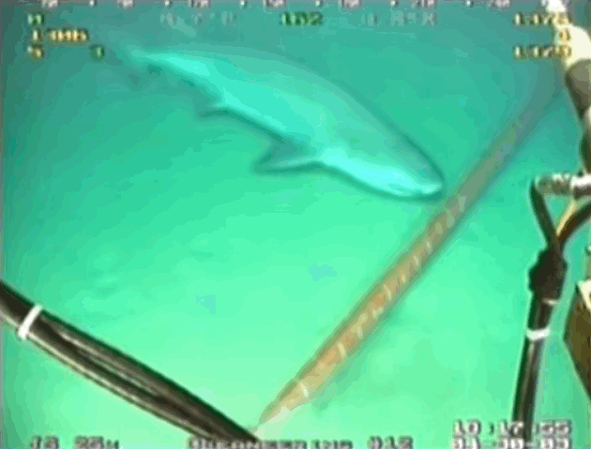
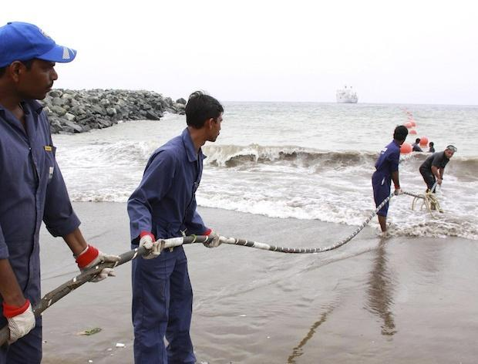
Notes:
But to build a global platform you also have to connect those datacenter and for us that means investing in our own private subsea cables across the Atlantic and Pacific. And as you see in the top right, we even had to take into account making them shark proof.

Slide 25

GCP VPC Example: VPC as “Fiber on demand”
Google VPC
US Region
US
Google HK PoP
HK
Notes:
In a traditional model, the overhead and cost associated with your deployment grows with each new region that must be added.

Slide 26
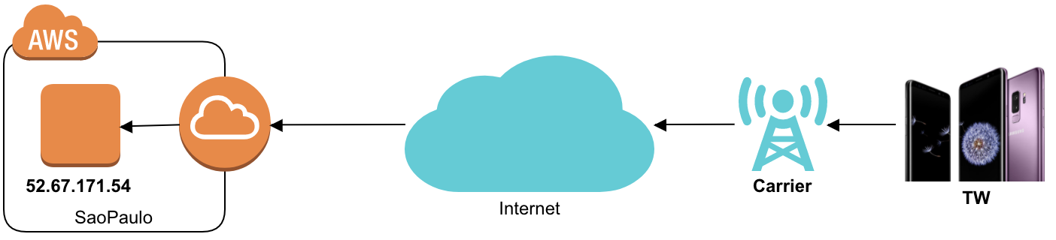
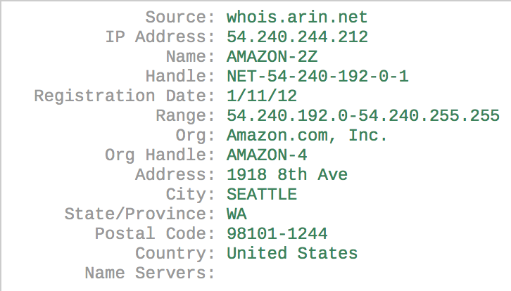
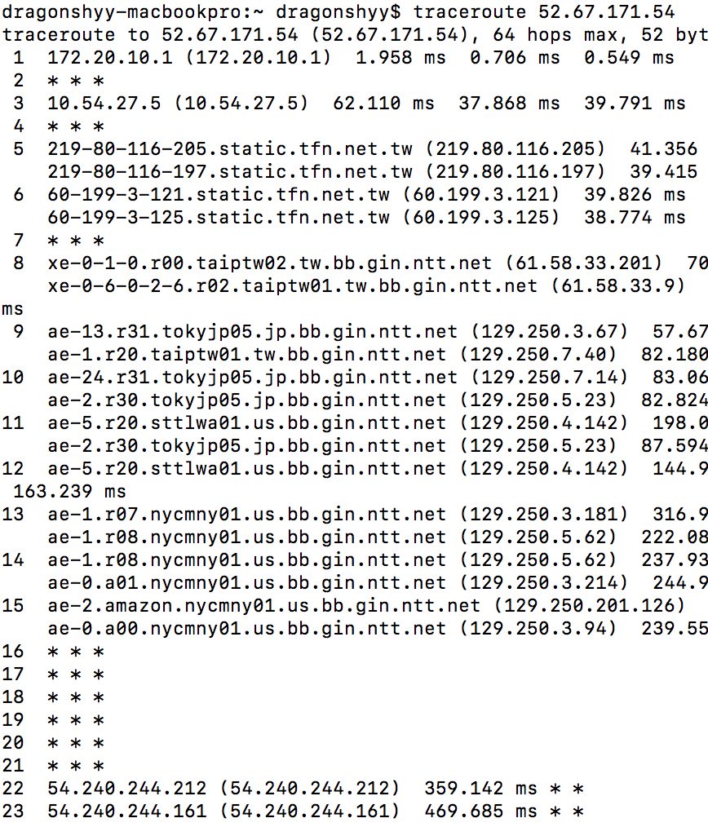
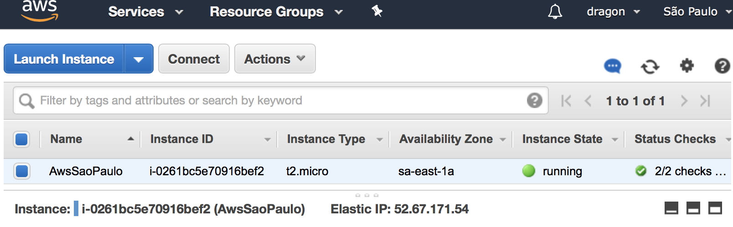
AWS Network
Carrier
Internet

Slide 27
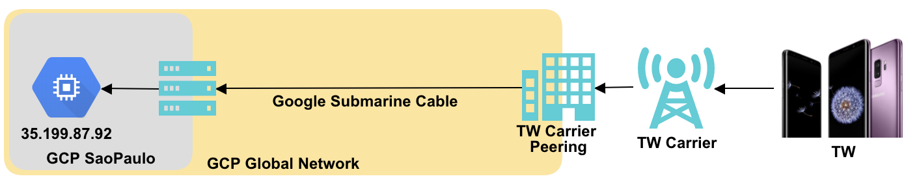
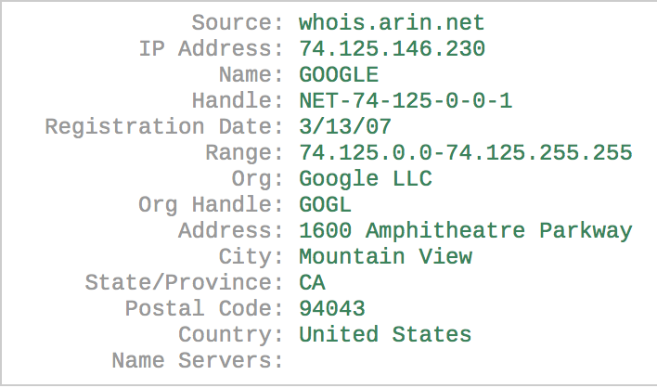
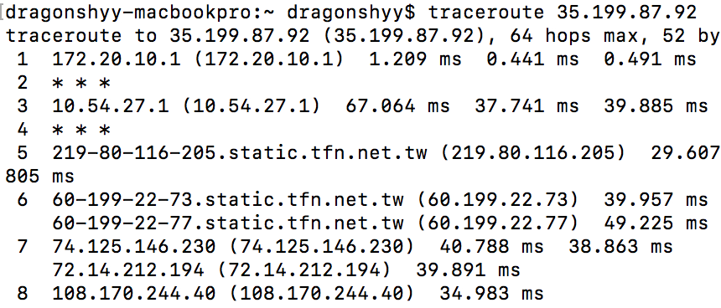
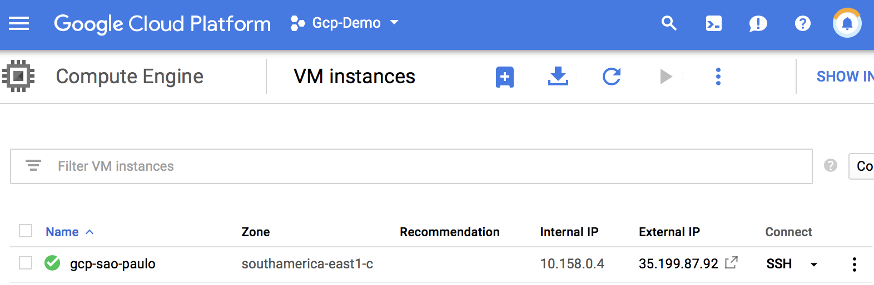
Carrier
Google

Slide 28
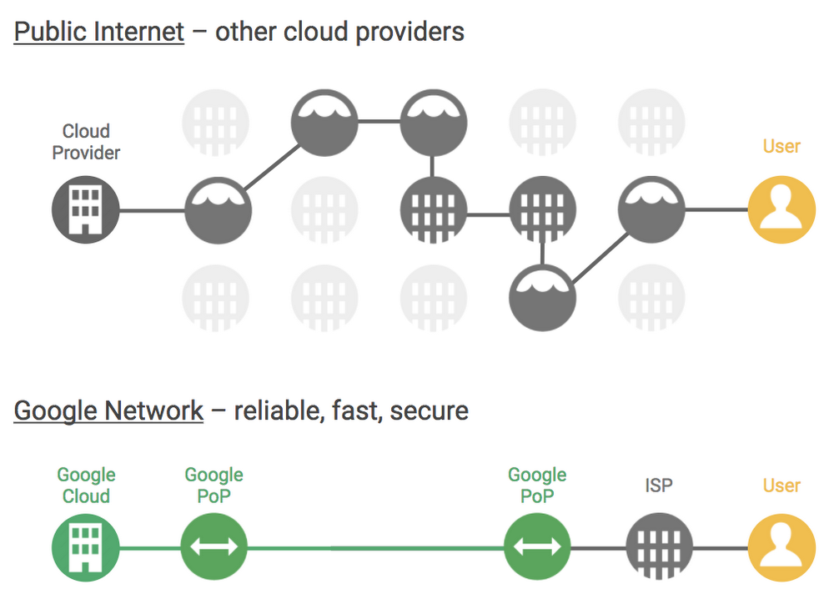
Notes:
Not only is this network larger, it also enables us to offer you a unique combination of speed AND reliability. Most cloud providers uses what’s called “hot potato” routing. When you’re sending out traffic from their infrastructure, they offload it to the public internet as soon as possible - that traffic is a hot potato they want off their hands.
But we don’t. We use “cold potato” - we keep that traffic on Google’s private network as long as possible and exit to the public internet at a location nearest to the end user - usually in the same city or town. That enables us to offer better reliability, better performance, and more security.

Slide 29
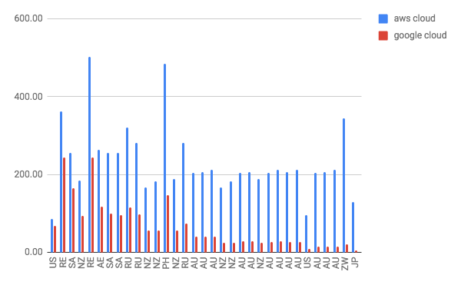
Internet performance comparison
Client to Cloud(US central) latency
Test is done by using http://maplatency.com (ping)
Latency (millisecond)
Client location (Country)

Slide 30
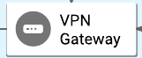

Google VPC is Global
AWS VPC
Google VPC
Cross region Peering
Internet
Google’s Submarine Cable
Traditional VPC
Traditional VPC
Google VPC
Application Server
Application Server
Application Server
Application Server
10.10.0.0/26
10.50.0.0/26
10.10.0.0/26
10.50.0.0/26
Tokyo
Sao Paulo
Tokyo
Sao Paulo

Slide 31


용도별 네트워크 가격 체계
Cost
Premium Network Tier
Global Network and Services
Standard Network Tier
Regional Network and Services
Network quality and performance
Quality comparable to other public cloud providers
Google Cloud’s premium offering (no comparable offering from any other public cloud provider)
저비용
AWS 등 타 클라우드와 유사한 품질
네트워크 트래픽이 특정 리전에 편중 된경우
Light use of Google global backbone
Examples: batch analytics / large data sets, non-critical workloads, etc.
높은 안정성과 빠른 성능이 필요한 경우
글로벌로 서비스를 제공하는 경우
높은 수준의 SLA가 필요한 경우
Examples: Enterprise, mobile apps, financial, gaming, e-commerce, critical / real-time workloads, etc.

Slide 32
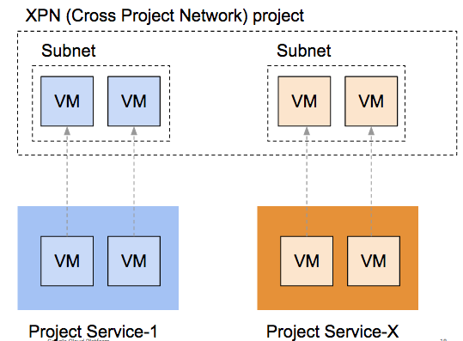

Shared VPC
Cross Project Network
여러개의 프로젝트를 같은 네트워크로 통합 가능
프로젝트별로 과금, 사용량 통제 가능
역할 분할 가능
중앙 관리 부서에서 네트워크 및 보안 설정 담당
개발 부서는 VM,DB 등의 일반 서비스 설정 및 사용
네트워크 정의
방화벽 통제
로드밸런서 설정
라우팅 경로 설정
중앙 운영 부서
VM 생성
오토스케일링
서비스 모니터링
각서비스개발팀

Slide 33
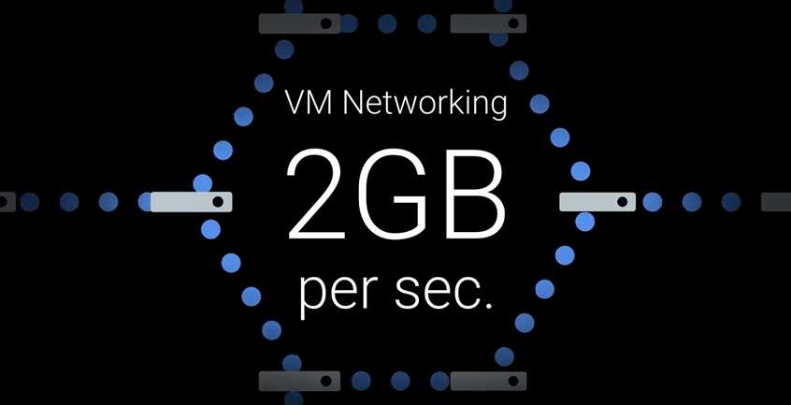
내부 네트워크
코어당 2GB 네트워크 대역폭 (최대 16GB)
분산 환경에 유용

Slide 34
Big Data
03

Slide 35






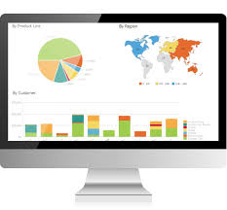


오픈소스 기반 데이타 분석 아키텍쳐
Fluentd
Ipython notebook
Zeppelin
Hadoop HDFS
Linux
Kafka
Spark streaming
Hadoop MR
User application
Spark

Slide 36
오픈소스 기반 데이타 분석 아키텍쳐
Monitoring
Programming
Performance tuning
Resource provisioning
데이타 분석 자체 보다.
데이타 분석 인프라를 설치 운영 하는데 많은 리소스가 소요됨
Utilization improvements
Handling Growing Scale
Deployment & configuration
Reliability

Slide 37




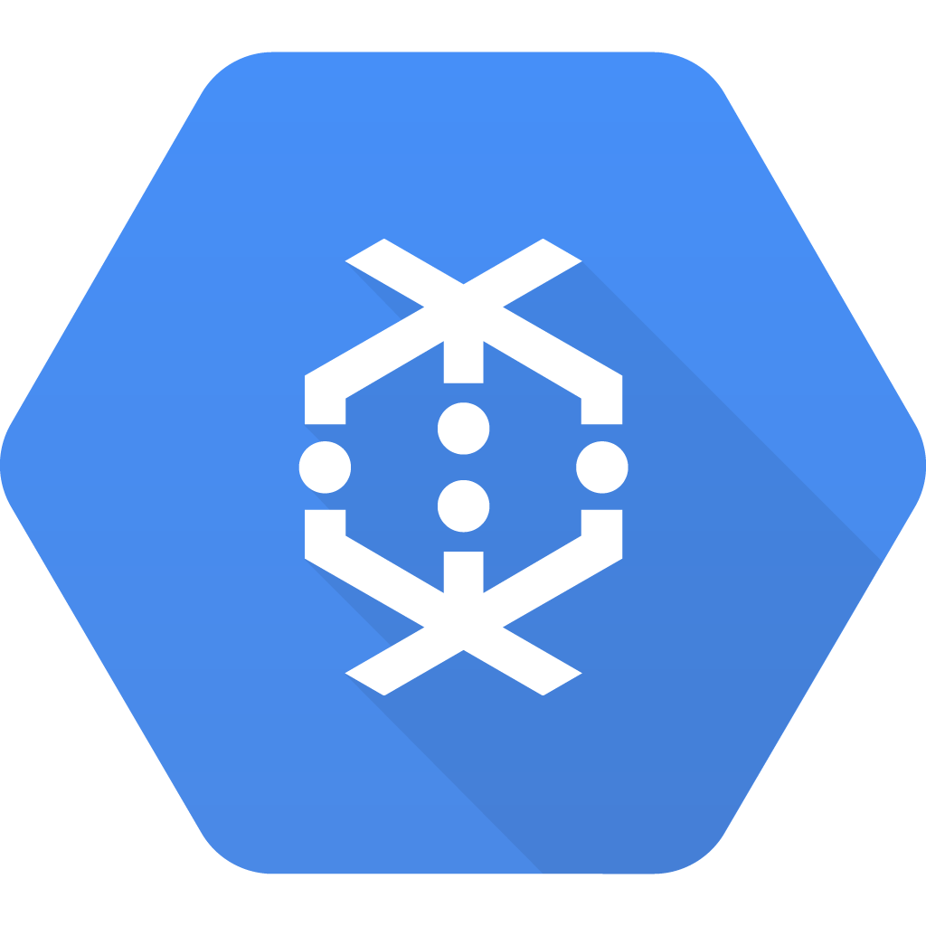
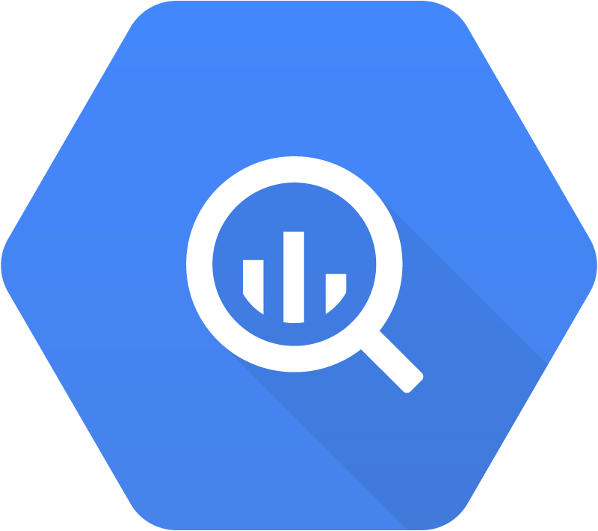

구글 클라우드 기반 아키텍쳐
Cloud Storage
Datalab
VM or AppEngine
Cloud Pub/Sub
Cloud Dataflow
BigQuery
DataStudio

Slide 38
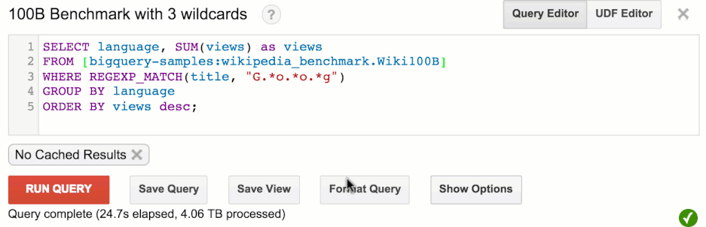
구글 빅쿼리
https://bigquery.cloud.google.com/
“ 1000억개(4.06TB) 의 문자열에 대해서 3개의 와일드 카드 연산을 수행 한후, 그룹핑 및 소팅을 하여 SUM을 구하는 연산 “

Slide 39
구글 클라우드 기반 분석
Programming
No-Ops (별도의 운영이 필요없음)
스케일 (30초 동안 8600개의 CPU, 3600개의 디스크)
비용 (4TB, 1000억개 레코드 분석에 20$)
Optimize your
time to answer
클라우드 스케일의 성능 (1000억 레코드 4TB 분석에 30초)

Slide 40






빅쿼리와 구글 솔루션 연동
Direct Import
Federated Query
BigQuery
Firebase
Adwords, DoubleClick, YouTube
Cloud Datastore
Cloud
SQL*
Cloud Storage
Cloud Bigtable
Cloud Spanner*
Google Analytics 360
*Roadmap
*Roadmap
Notes:
Big Picture: once data is in bigQuery.. Bigquery can feed more advanced workloads: analytics, etc
As a serverless and cloud-based service, BigQuery is constantly connected. This allows automated data import and queries at scale.

Slide 41
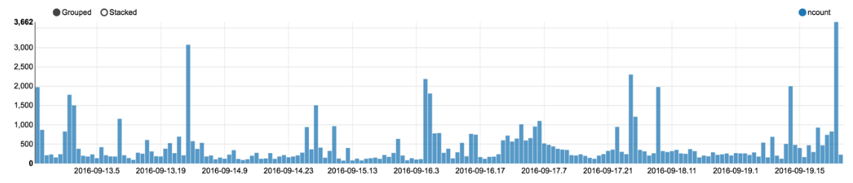
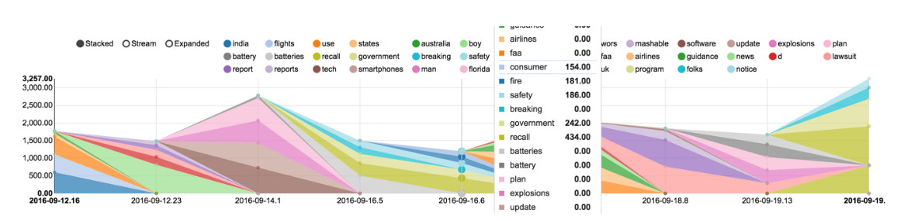
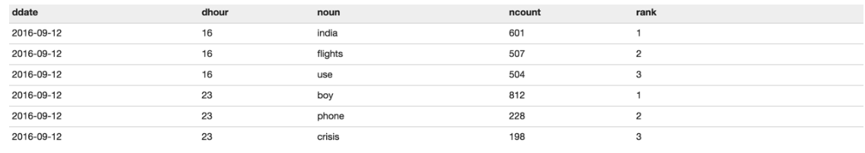
CASE STUDY-삼성 갤럭시 노트 7 SNS 반응 실시간 분석
트위터 피드를 읽어서
피드의 NLP (자연어 처리 API)를 이용하여, 주요 이슈, 글의 감정 상태등을 분석

Slide 42
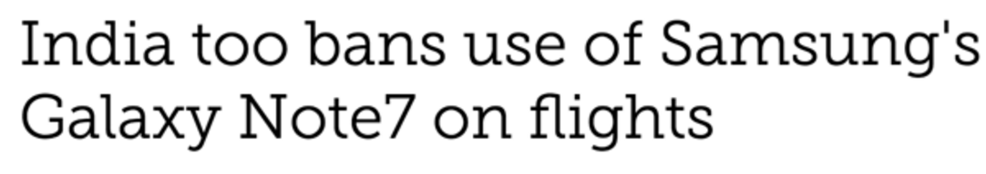
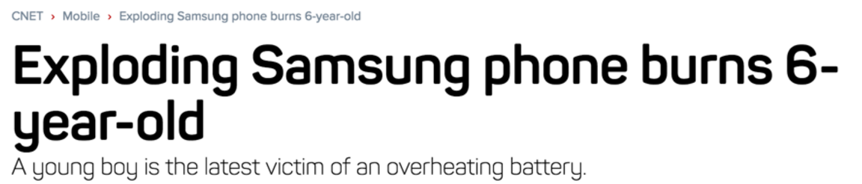
CASE STUDY-삼성 갤럭시 노트 7 SNS 반응 실시간 분석
9-12 16:00
(india, flight,use)
9-12 23:00
(boy)

Slide 43
CASE STUDY-삼성 갤럭시 노트 7 SNS 반응 실시간 분석
삼성 갤럭시 노트 7의 SNS 반응 실시간 분석
일반 엔지니어 혼자서 하루에 개발
한달 운영 비용 $400

Slide 44
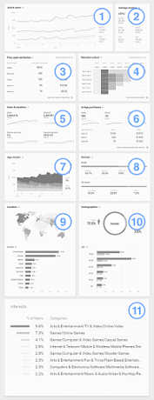
Firebase analytics (Mobile App - Android & iOS)
활성 사용자수 (Active User)
평균 수익 (Average Revenue / aka. ARPU)
앱 실행 빈도 (first_open attribution)
사용자 잔존율 (Retention cohort)
사용자 활동 지표 (User engagement)
인앱 구매율 (In-App purchase)
앱 버전 (App version)
디바이스 정보 (Devices)
위치 (Location)
성별 및 연령등 데모 그래픽 정보 (Demographic 정보)
사용자 관심사 (Interst)

Slide 45
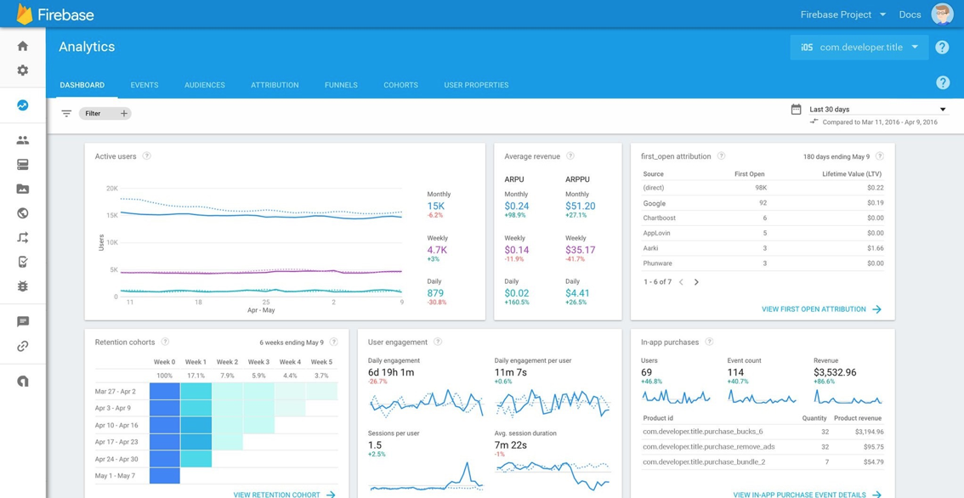
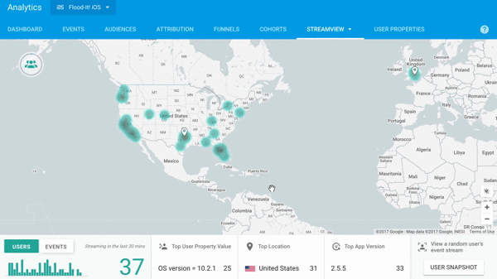
StreamView : a sneak preview
An inspiring live view of your analytics data

Slide 46
















구글 빅데이타 분석 플랫폼
Capture
Store
Process
Analyze
Visualize
Cloud Pub/Sub
Logs, App Engine
BigQuery streaming
Cloud
Storage (objects)
Cloud SQL
(SQL)
BigQuery Storage (structured)
Cloud Bigtable
(NoSQL
HBase)
Cloud
Datastore
(NoSQL)
Cloud Dataflow
(stream and batch)
BigQuery
(large scale SQL)
Cloud Machine Learning
Cloud DataLab (iPython/Jupyter)
Cloud 3.0
Cloud Dataproc
Cloud 2.0
Rabbit MQ
Kafka
Cassandra
hBase
MongoDB
Hadoop & Ecosystem
Tableau
Qlik
@thetinot

Slide 47
BigQuery
DML
GDPR
Do we always have to delete personal data if a person asks? (Link)
→ It can delete & update row in BigQuery (DML)

Slide 48

Mask, de-ID, and transform data
Consider transforming data to further reduce risk of exposure.
Examples:
Scan and redact sensitive data to prevent inadvertent collection
Tokenize PII before sharing instead of sending raw identifiers.
Example Techniques:
Dynamic masking and redact data
Format preserving encryption
Date shifting
Bucketing

Slide 49

Automating
Classification
In Storage
Using DLP & Cloud Functions
Low sensitivity bucket
Ingestion
Bucket
High sensitivity bucket

Slide 50

Visualize Findings in Data Studio

Slide 51
Machine Learning
04

Slide 52
Two + 1 choice of Machine Learning implementation
To implement machine learning in production system, there are two+1 choices depends on your needs
Just use it (ML API)
There are lots of pre-trained machine learning model, which is served by simple SDK. You don’t need to develop train the model, just simply use it !!
Train & Use it (AutoMLI)
You can train your model by bringing your own data. AI will generate model which fit to your business. You can just use high quality model.
Develop model by yourself
You can develop and train model by yourself with your custom data
Non Expert without data
Non Expert with data
Expert with data

Slide 53





ML API
Pre-trained model
Just use it
Cloud Translation API
Cloud Vision API
Cloud Natural Language
Cloud Speech API
Cloud Video Intelligence

Slide 54

AutoML
Neural Architecture Search
Automatically generate Neural network

Slide 55


AutoML
Notes:
Key Message: AutoML research results are promising, beating Fei Fei and the Jeffs at their own game.
Like Go and self driving cars… deep learning is now doing… deep learning.
We have an AI, creating its own progeny. That’s wild.
This graph was published in August and represents a decade of the best minds in the world, trying to win the ImageNet contest of Fei Fei Lee.
The X axis is model size. The Y axis is accuracy.
What you want… is like nature… a small model (left on the X) with great accuracy (top of the Y).
Our world has been trending towards big, heavy, models that aren’t exactly like a brain. That’s the yellow line.
This AutoML, which eats supercomputers for breakfast, is shown in the blue line.
The AutoML networks are smaller, more efficient, and better than the best in the world today.
And that’s barely version 1.0, just in our labs now.

Slide 56








AutoML Vision
Upload and label images
Train your model
Evaluate
Cloud AutoML
Handbag
Shoe
Hat
Model is now trained and ready to make prediction. This model can scale as needed to adapt to customer demands.

Slide 57


AutoML Vision
I want to know whether a photo of a car interior shows…
No damage
Damage

Slide 58

AutoML Vision
사례 LCD 패널 불량 검출
기존 학습데이타를 넣고 학습만 시킴
기존 머신러닝 팀에서 모델 보다 높은 정확도

Slide 59

머신러닝에 대한 잘못된 생각
This is ML Code
https://papers.nips.cc/paper/5656-hidden-technical-debt-in-machine-learning-systems.pdf

Slide 60
머신러닝 파이프라인
Integrated Frontend for Job Management, Monitoring, Debugging, Data/Model/Evaluation Visualization
Shared Configuration Framework and Job Orchestration
Tuner
Focus of this paper
Data Ingestion
Data Analysis
Data Transformation
Data Validation
Trainer
Model Evaluation and Validation
Serving
Logging
Shared Utilities for Garbage Collection, Data Access Controls
Pipeline Storage
Figure 1: High-level component overview of a machine learning platform.

Slide 61








구글 클라우드 기반 머신러닝 러닝 파이프라인
Collect & store
Gather & Store data from data source
Explore data
Explore raw data and find meaningful data and relationships
Preprocessing
Filtering and transforming data to feed machine learning model
Develop model
Design machine learning model and experiment model
Training
Train ML with big data
Prediction
Run prediction with trained model
Google Cloud Storage
Big Query
Google Datalab
Google Dataflow
Google Datalab
CloudML
CloudML
FULLY MANAGED SERVICE

Slide 62



Hardware Accelerated AI
Notes:
And we call that something a Tensor Processing Unit or TPU. You probably already know about CPUs and GPUs. Well, a TPU is like that but it’s a processor custom-designed by Google for the purpose of running TensorFlow really really fast. And it’s a key part of how we’ve been able to deploy ML across so many products and so many users.

Slide 63

TPU vs Conventional processors
15 - 30x faster
30 - 80x operations per watt
Like fast-forwarding 7 years into the future
Jeff Dean, Google Senior Fellow
2014
Notes:
The power of a TensorFlow is that it’s 15 to 30 times faster than conventional chips at training and running models. And even more significantly, it’s 30 to 80 times faster per watt of power. That like a 7 year jump into the future compared with the rate processors typically advance.
SOURCE: GCP Blog https://cloud.google.com/blog/big-data/2017/05/an-in-depth-look-at-googles-first-tensor-processing-unit-tpu

Slide 64

TPU Performance

Slide 65

TPU Price Performance

Slide 66

Edge TPU Photo

Slide 67



Edge TPU board

Slide 68
Agile development
05

Slide 69


Retrica
카메라 앱
글로벌 서비스
21M DAU,1억+ 다운로드
Architecture

Slide 70
Retrica
개발 운영 = 서버 엔지니어 1명
데이타 분석 = 1명

Slide 71

구글 앱앤진
https://www.youtube.com/watch?v=fQuy6ZkWiO8&feature=youtu.be

Slide 72


Zero Ops
Focus on code, not managing infrastructure. Fully managed by Google site reliability engineers.

Slide 73


간편한 배포와 롤백
복잡한 배포툴이나 프로세스가 필요 없음
배포
롤백

Slide 74


트래픽 분할을 통한 카날리 테스팅 (& AB 테스팅)
버전별 트래픽 분할 (V2 : 30%, V1 : 10%)

Slide 75
Google App Engine Flex
로컬 디스크를 쓰고 싶다
더 큰 인스턴스를 쓰고 싶다
디버깅을 위해 SSH로 로그인을 하고 싶다
모니터링 에이전트를 깔고 싶다
node.js 를 쓰고 싶은데..
나만의 PaaS 를 만들 수 는 없을까?
몽고DB와 REDIS를 쓰고 싶다
→ 로컬 디스크 마운트 가능
→ 32 CPU, 208 GB
→ SSH 로그인 가능
→ Custom Image
→ Java,Go,Ruby,Python,PHP, node
→ Custom Image
→ GCE와 Private Network로 연결, VPN지원

Slide 76

하이브리드 아키텍쳐
Static contents
GCS
Static contents
API servers (AppEngine)
Data base (GCE)
API calls
api.com/users
node.js / GAE
mongoDB / GCE
api.com/products
python / GAE
Redis / GCE
:
private IP
PaaS
IaaS
Same network

Slide 77

Firebase

Slide 78


카우치 그램

Slide 79

AWS 기반 아키텍쳐

Slide 80







구글 기반 아키텍쳐
GCP
11
2
Users
BigQuery
API server
RDS(CloudSQL)
3
M
S
AppEngine

Slide 81
결과
월 비용 : 100K → 10K (1/10)
리전 : 6 → 1개
성능 : 회원 가입 1.1초 → 300 ms
배포 : 1시간 → 7~10분
운영 대신 개발에 집중

Slide 82
MicroService Architecture
& Container
06

Slide 83

What is Docker?
Docker is a software platform for building and running containers.
The Docker Engine is the container runtime that builds, runs, and monitors containers.
It uses underlying Linux kernel features such as cgroups, namespaces, and copy-on-write storage.
Docker Engine is not the only container runtime. Other runtimes include LXC, systemd-nspawn, CoreOS rkt, and more.
others:
LXC
systemd-nspawn
rkt
...
*Images provided by Docker

Slide 84
Where to we deploy container?
Container
2 CPU, 4GB
Where ?
Node
Node
Node
Node
Node
Container
…...

Slide 85

Container mgmt tool trend

Slide 86


Kubernetes
Open source container management solution
Support multiple environment, including “Your laptop”, “bare metal”, “OpenStack”, “Google Cloud”,”Amazon Web Service”, “MS azure”
Implemented by Go lang

Slide 87





GKE - support for on-premise containers
Orchestrate and manage on-premise containers just like GKE in the cloud
Consistent operating model with access to GCP services across hybrid environments
Single-pane-of-glass for multiple Kubernetes clusters, no matter where
87

Slide 88
$ gke-on-prem create cluster --dry-run Welcome! This command will take you through the installation of a cluster. --dry-run saves your configuration to a YAML file. Please enter the path of a directory where this configuration will be saved? [/Users/karangoel/my-test-cluster/]: Where do you want to install your cluster? [1] vSphere v6.5 Please enter your numeric choice [1]: 1 What version of GKE On-Prem do you want to install? [1] 1.10.3 (Uses k8s v1.10.3) [2] 1.9.2-rc2 (Uses K8s 1.9.2) [3] 1.8.3 (Uses K8s 1.8.3) Please enter your numeric choice [1]: 1 Pulling gke-on-prem-vsphere-1.10.3... DONE Path to kubeconfig for the GKE On-Prem Admin Control Plane (leave empty to create it): A GKE On-Prem Control Plane will be created. Would you like to use existing CA? [1] I'll provide CA certificate and key [2] Generate CA certificate and key Please enter your numeric choice [2]: 2 Enter the path to the SSH private key to use (leave empty to generate): /Users/karangoel/.ssh/vsphere Enter proxy without "http://" or "https://" (leave blank if none): username:password@1.1.1.1:5413/ Enter Docker registry to use [gcr.io/k8s-cluster-api]:
CLI (Installation)

Slide 89

Register with Google Cloud Console

Slide 90
Securing Your Connection to GCP
GCP
GCP Services
Single-Pane of Glass
GKE Connect Agent installs in your cluster
Encrypted connection from the K8s cluster to GCP
No public IP required for your cluster
Can traverse NATs & egress firewalls
Container Registry & Builder
Connection Proxy
Market-
place & Service-
Catalog
Stackdriver
End-User
On-Prem/Public Cloud Provider
Any K8s Cluster
K8s API Server
Connection Agent

Slide 91

Single Pane of Glass across GCP & On-Prem
Orchestrate and manage on-prem containers just like GKE in the cloud
Consistent operating model with access to GCP services across hybrid environments
Single-pane-of-glass for multiple Kubernetes clusters, no matter where

Slide 92


Announcing Istio 1.0 - Service Automation
...and managed Istio from Google
Cloud Services Platform
It enables developers and operators to define composable services that can be managed and consumed as part of a cloud services platform or broader SaaS solution
Istio Service Mesh provides a transparent and language-independent way to flexibly and easily automate application network functions:
Control, configure and monitor app-level requests
Ensure service auth, resilience, routing, observability, fault-injection
Automatic policy enforcement at scale
Application/Services
Business logic to accelerate business agility
Developer and admin experience abstracted
Istio
Cloud Services Platform includes a fully managed implementation of Istio, integrated with GCP capabilities like Global Load Balancing
Infrastructure-as-a-Service
Compute (VM’s), network, and storage
Resource /component infra management

Slide 93



Architectural components
Envoy architecture
Service A
HTTP/1.1, HTTP/2, gRPC or TCP -- with or without mTLS
Service B
Pilot: Control plane to configure and push service communication policies.
Envoy: Network proxy to intercept communication and apply policies.
Mixer: Policy enforcement with a flexible plugin model for providers for a policy.
Istio Auth: Service-to-service auth[n,z] using mutual TLS, with built-in identity and credential management.
proxy
proxy
Policy checks, telemetry
Config data to Envoys
TLS certs to Envoys
Pilot
Mixer
Istio Auth
Control Plane API

Slide 94
Life of a request in the mesh
Service A
Service B
Service A comes up. Envoy is deployed with it and fetches service information, routing and configuration policy from Pilot. If Istio Auth is being used, TLS certs are securely distributed as well.
proxy
proxy
Routing and load balancing config to Envoys
TLS certs to Envoys
Pilot
Mixer
Istio Auth
Notes:
Interior slide with 3 columns of text

Slide 95
Life of a request in the mesh
Service A
Service B
Service A places a call to service B.
Client-side Envoy intercepts the call.
Envoy consults config to know how/where to route call to service B.
proxy
proxy
Pilot
Mixer
Istio Auth
Notes:
Interior slide with 3 columns of text

Slide 96
Life of a request in the mesh
Service A
HTTP/1.1, HTTP/2, gRPC or TCP -- with or without mTLS
Service B
Envoy forwards request to appropriate instance of service B. There, the Envoy proxy deployed with the service intercepts the call.
proxy
proxy
Pilot
Mixer
Istio Auth
Notes:
Interior slide with 3 columns of text

Slide 97
Life of a request in the mesh
Service A
Service B
Server-side Envoy checks with Mixer to validate that call should be allowed (ACL check, quota check, etc).
proxy
proxy
Policy checks, telemetry
Pilot
Mixer
Istio Auth
Notes:
Interior slide with 3 columns of text

Slide 98
Life of a request in the mesh
Service A
Service B
Mixer checks with appropriate adaptors (policy engine, quota adaptor) to verify that the call can proceed and returns true/false to Envoy
proxy
proxy
Policy checks, telemetry
Pilot
Mixer
Istio Auth
Policy Engine
Quota Adaptor
Notes:
Interior slide with 3 columns of text

Slide 99
Life of a request in the mesh
Service A
Service B
Server-side Envoy forwards request to service B, which process request and returns response
proxy
proxy
Pilot
Mixer
Istio Auth
Notes:
Interior slide with 3 columns of text

Slide 100
Life of a request in the mesh
Service A
Service B
Envoy forwards response to the original caller, where response is intercepted by Envoy on the caller side.
proxy
proxy
Pilot
Mixer
Istio Auth
Notes:
Interior slide with 3 columns of text

Slide 101
Life of a request in the mesh
Service A
Service B
Envoy reports telemetry to Mixer, which in turn notifies appropriate plugins
proxy
proxy
Pilot
Mixer
Istio Auth
Logging plugin
Monitoring plugin
Notes:
Interior slide with 3 columns of text

Slide 102
Life of a request in the mesh
Service A
Service B
Client-side Envoy forwards response to original caller.
proxy
proxy
Pilot
Mixer
Istio Auth
Notes:
Interior slide with 3 columns of text

Slide 103
Life of a request in the mesh
Service A
Service B
Client-side Envoy reports telemetry to Mixer (including client-perceived latency), which in turn notifies appropriate plugins
proxy
proxy
Pilot
Mixer
Istio Auth
Logging plugin
Monitoring plugin
Notes:
Interior slide with 3 columns of text

Slide 104


Mixer: Pluggable control plane
Called by Envoy to gate traffic & report telemetry
Response caching in Envoy for amortization
Pluggable component for integrating monitoring & logging systems, policy and more
Execution Phases
Receives base set of ‘attributes’ from Envoy
Supplements attributes based on environment
Selects behavior to apply based on attributes
Passes attributes to adapters which implement rules
Sends applied rules as a response
frontend
pictures
proxy
proxy
API: /pictures
Latency: 10ms
Status Code: 503
src: 10.0.0.1
dst: 10.0.0.2
Mixer
Prometheus
InfluxDB
Custom

Slide 105


Cloud Services Platform
Stackdriver Service
Monitoring
Full observability for Istio and GAE services and topology
Service dashboard Incorporates infrastructure, container and application management and monitoring
Set, monitor and alert on specific Service Level Obligations
Speeds time to root cause analysis and resolution
105

Slide 106
CI/CD & Monitoring
07

Slide 107


Slide 108


Slide 109


Slide 110


Slide 111




Phoenix server pattern
Bakering new image
VM
Application
Load balancer
Middleware
VM image
Patch
vm
vm
...
vm
deploy
OS
Bakering image
VM image

Slide 112

Spinnaker
Spinnaker is an open-source, multi-cloud, continuous delivery platform for releasing software changes with high velocity and confidence.
Spinnaker provides cluster management as well as deployment management within the cloud.

Slide 113

Spinnaker: Cluster Management
Allows users to view and manage resources in the cloud using server groups, clusters, applications, load balancers, and security groups.
Notes:
Server Group
The base resource, the Server Group, identifies the deployable artifact (VM image, Docker image, source location) and basic configuration settings such as number of instances, autoscaling policies, metadata, etc. This resource is associated with a Load Balancer and a Security Group. When deployed, a Server Group is a collection of instances of the running software (VM instances, Kubernetes pods).
Server groups follow the application-stack-detail-version naming convention.
Cluster
You can define Clusters, which are logical groupings of Server Groups in Spinnaker. These groups are based on the application-stack-detail naming convention.
Applications
Applications are logical groupings of Clusters in Spinnaker from the application-stack-detail naming convention.
Load Balancer
A Load Balancer is associated with an ingress protocol and port range. It balances traffic among instances in its Server Groups. Optionally, you can enable health checks for a load balancer, with flexiblity to define health criteria and specify the health check endpoint.
Security Group
A Security Group defines network traffic access. It is effectively a set of firewall rules defined by an IP range (CIDR) along with a communication protocol (e.g., TCP) and port range.

Slide 114

Spinnaker: Cluster Management
Single pane of glass to manage global deployments across multiple clouds.
Surface health and status of running environments and metadata around deployments and individual instances.
Combines health monitoring with an actionable UI to resolve issues

Slide 115

Spinnaker: Deployment Management
Allows users to construct and manage continuous delivery workflows using pipelines and stages.
Pipelines consist of a sequence of actions, known as stages.
Notes:
Server Group
The base resource, the Server Group, identifies the deployable artifact (VM image, Docker image, source location) and basic configuration settings such as number of instances, autoscaling policies, metadata, etc. This resource is associated with a Load Balancer and a Security Group. When deployed, a Server Group is a collection of instances of the running software (VM instances, Kubernetes pods).
Server groups follow the application-stack-detail-version naming convention.
Cluster
You can define Clusters, which are logical groupings of Server Groups in Spinnaker. These groups are based on the application-stack-detail naming convention.
Applications
Applications are logical groupings of Clusters in Spinnaker from the application-stack-detail naming convention.
Load Balancer
A Load Balancer is associated with an ingress protocol and port range. It balances traffic among instances in its Server Groups. Optionally, you can enable health checks for a load balancer, with flexiblity to define health criteria and specify the health check endpoint.
Security Group
A Security Group defines network traffic access. It is effectively a set of firewall rules defined by an IP range (CIDR) along with a communication protocol (e.g., TCP) and port range.

Slide 116

Monitoring : too many disparate tools….
Infrastructure Monitoring
Application Monitoring
Licensing Cost
Alerting
Uptime Monitoring
Infrastructure Logging
Metric Visualization
System Monitoring
Custom Metrics
System Logging
Error Reporting
and high total cost of ownership

Slide 117








Our vision: single pane of glass for multi-cloud
Monitoring
Logging
Debug
Trace
Error Reporting

Slide 118

Stack driver logging
Query multiple logs for events or issues
Log retention is 7 days or 30 days

Slide 119

Exports & Integrations
Export logs to Cloud Storage, BigQuery, Cloud Pub/Sub
Ways to Export
Logs Export panel in Logs Viewer
Command-line SDK
Stackdriver Logging API
Create Sinks to direct your logs for exporting
Datalab/Cloud ML Integration

Slide 120

Stackdriver Error Reporting

Slide 121

Stackdriver debug

Slide 122

Stackdriver trace

Slide 123
Customer feedback
분석만 하고 싶은데 EMR/Hive 쓸때는 장애도 자주 나고 뭘 고쳐야 되는지 잘 모르는 경우가 많았음. 빅쿼리 쓰고 나서는 정말 분석만 하면 됨.
EMR/Hive 비교 쿼리 성능 훨씬 빠름.
UDF Javascript 써서 원하는 쿼리를 쉽고 깔끔하게 짤 수 있음.
Amazon Athena 테스트해봤는데 기능이 너무 부족해서 쓸 수 없었음.
BQ Streaming도 되서 실시간성 지표 업데이트되서 좋음.

Slide 124


Slide 125
Security
08

Slide 126






Purpose-built hardware infrastructure
Provenance from the bottom of the stack to the top
Purpose-built chips
Purpose-built servers
Google Security Engineering
Purpose-built network
Purpose-built data centers
Reduced “vendor in the middle” risk
Notes:
Our hardware infrastructure is custom-designed by Google “from chip to chiller” to precisely meet our requirements, including security.
Google’s servers and their OS are designed for the sole purpose of providing Google services. Our servers are custom built and don’t include unnecessary components like video cards or peripheral interconnects that can introduce vulnerabilities. The same goes for software, including low-level software and our OS, which is a stripped-down, hardened version of Linux. Further, we design and include hardware specifically for security - like Titan - our custom security chip that we use to establish a hardware root of trust in our servers and peripherals. We build our own network hardware and software to improve performance as well as security. This all rolls up to our custom data center designs, which include multiple layers of physical and logical protection.
Understanding provenance from the bottom of our hardware stack to the top allows us to control the underpinnings of our security posture. Unlike other cloud providers, we have greatly reduced the “vendor in the middle problem” - if a vulnerability is found, we can take steps immediately to develop and roll out a fix. This level of control results in greatly reduced exposure for us and our customers.

Slide 127





Encryption by Default at Google
In transit
At rest
In use
Notes:
Note - in use might be confusing. As we don’t practically encrypt in use.
Intro to the problem
Data protection, and encryption specifically, are just one part of a broader security story.
We like to think of encryption in three states: at rest, in transit, and in use.
Encryption at rest helps protect against a system compromise, say, or data exfiltration by an insider - it’s used to encrypt data while it is being stored. It’s the base layer of protection, and protects your data in case it’s lost or stolen. For example, the Advanced Encryption Standard (AES) is a type of encryption at rest.
This is what we’ll be focused on during our presentation today.
Encryption in transit is used between the customer and the cloud provider, to encrypt the data prior to transmission, authenticate the endpoints, and decrypt and verify it upon arrival. This protects your data in case your communications are intercepted. For example, Transport Layer Security (TLS) is a type of encryption in transit.
Google Cloud Platform defaults to HTTPS to our front end. We have upgraded all of our RSA certificates to 2048-bit keys, and we use perfect forward secrecy to minimize the impact of a potential future breakthrough in cryptography. We were the first major cloud provider to implement perfect forward secrecy. Google encrypts remote procedure calls as they move between our data centers on our private network.
The last concept, encryption in use, is a newer idea - how can you perform computations on encrypted data, so that even the server performing the calculation doesn’t see the data? This protects your data where you don’t trust the server running the computations - it’s honest but curious. You trust that it will perform the computation correctly, but still do not trust it with the contents of the data. For example, fully homomorphic encryption could be used, but it is not computationally practical. This is an exciting field that Google is doing a lot of research into, but sadly it's waaay beyond the scope of this talk.

Slide 128








Strong Authentication
Second Factor (2FA)
Phishing resistant accounts for employees and administrators
Auditing and logging tools
A BeyondCorp model
REUSE
PHISHED
INTERCEPTED
KEYLOGGED
cloud.google.com/securitykey
Notes:
Section: Securing Google
Title: Secure Auth
Time Required: 1 minute
Owner: Alan Poole (alanpoole@google.com)
Key Points:
Social engineering attacks on employees are common; Google employees are just as vulnerable as your employees
Google invested in Security Keys, a more secure and simple second-factor hardware sign-in workflow
Security Keys can be used today in Google Cloud products; FIDO alliance is an open standard.
Talk Track:
As a part of BeyondCorp, a secure identity is an important aspect of the risk model for determining access (not the only aspect). Unfortunately, usernames, passwords, and even simple Second Factor schemes, such as six-digit OTP, are vulnerable to a variety of attacks. At Google, one of the top social engineering vulnerabilities is Phishing. As a mitigation, Google has invested in the development of Security Keys and requires them for all Google employees. In addition to corporate issued devices, we hand Security Keys out to every new hire on day one. These simple second factor pieces of hardware enable Google to control the sign-in flow and dramatically reduce the threat. Google employees are just as vulnerable to social engineering attacks as your employees. Because of this threat, it is easy for you to enable and require the use of Security Keys with Google Cloud products. In fact, the FIDO alliance is an open standard.
Public Source: https://cloud.google.com/security-key/
Presenter Action(s):
None

Slide 129

Cloud Audit Logging
Determine “who did what, where, and when” on GCP
Events are available to users in the Cloud Console and alongside other logs in Stackdriver with no configuration
Notes:
Notes:
Cloud Audit Logging provides log streams for each integrated product allowing you to see who did what, where and when.

Slide 130

What is the Cloud Security Command Center?
Solve the problem of missing holistic and unified risk view of your GCP footprint
Security analytics engine/pipeline for organizations
Organization level view and understanding of asset and data footprint
Built-in security scanning:
Security Analytics - Risk Assessment
Signals in
Curated insights and raw data out - API’s and/or GCP “Pane of Glass”
Manual and auto remediation launch pad
Alpha release June 2017

Slide 131
Pricing
09

Slide 132


Notes:
This is the graph of the energy use during the experiment. You can literally see when we turned on the model. We let it run for a while and didn’t believe it since it was so we turned it off and the the energy use went right back up.
Needless to say, we’ve since rolled out ML models to control our cooling systems across the fleet.

Slide 133

가격 비교
Avg. GCE provisioning optimization
100%
19%
List price differences
80%
Up to 59% savings
60%
Other Cloud Providers
26%
Customer friendly pricing*
Your
Workload
40%
14%
20%
0%

Slide 134

초당 과금 및 자동 할인 (Sustained Usage Discount)
초당 과금
리소스(VM) 사용량을 분당 과금 (기본 10분 사용량 과금 + 분단위 사용량)
타사의 경우 시간당 과금으로 1시간 1분을 사용해도 2시간으로 과금
사용량에 따른 월별 자동 할인 (최대 30%)
월별 리소스 사용량에 따라 한달에 25% 이상 사용시 단계적으로 월 사용량 최대 30% 과금
타사의 경우 1년이상 장기 계약시에 할인이 되며, 이 경우 계약된 구세대 인스턴스를 약정 기간동안 계속 사용해야 함

Slide 135


누적 사용량 합산 할인
인스턴스 사용량 합산하여 할인
개별 인스턴스 사용량이 아니라, 전체 인스턴스 사용량을 합산하여 최대한 할인 인스턴스 A를 30%, 인스턴스 B를 30% 인스턴스 C를 20%, 인스턴스 D를 20% 쓴다면 할인이 되는가? A,B,C,D의 총 사용량이 월 100%가 되기 때문에, A,B,C,D의 금액중 전체를 30% 할인을 제공 ※ 타사의 경우, 인스턴스 A,B,C,D 를 각 인스턴스의 사용량 만큼만 과금하고 별도의 할인 없음
인스턴스 타입이 달라도 합산하여 할인 작은 인스턴스 스펙으로 잘라서 이 사용량을 묶은 후에, 할인을 하는 방식, 우측 그림 처럼 2CPU 4G 인스턴스 50%, 4 CPU, 8G 인스턴스 50%를 사용하면, 4GB 8G 인스턴스의 사용량을 앞의 2 CPU 4G에 맞춰서 합산해서 100%로 계산하고 남은 2 CPU, 4G로 50% 사용한량은 별도로 과금

Slide 136
인스턴스 사이즈 커스터마이징
커스터마이징이 가능한 인스턴스 타입
필요에 따라 필요한 만큼의 CPU와 메모리만 설정해서 인스턴스 생성 가능 CPU가 많이 필요하면, CPU만 추가하고, 메모리가 많이 필요하면 메모리만 늘려서 사용하면됨, 타사의 경우 CPU가 많이 필요한 경우 큰 인스턴스를 사용해야만 하고, 이경우 불필요하게 남는 메모리에 대한 부분도 비용을 지불해야 함
자동할인으로 별도의 비용 최적화를 위한 비용 절약
일반적인 클라우드의 경우 시간당 과금, 인스턴스 사이즈 제약, 장기 계약에 의한 할인 정책에 최적화 하기위해 별도의 비용 최적화 단계가 필요함 구글 클라우드의 경우 분당 과금, 자동 합산 과금, 커스터마이징이 가능한 인스턴스등으로 비용 최적화 단계가 간소화되어, 비용 최적화를 위한 비용(인건비, 시간)등이 절약됨 (자동으로 해줌)

Slide 137
Preemptible VM
정상 VM 가격의 20% 가격 (80% 할인)
생성 후 24시간 사용 (재생성 가능)
배치가 대규모 연산에 사용 가능 (유전자 분석에 56,000 코어 사용 사례)

Slide 138

Preemptible VM

Slide 139

머신러닝 기반 VM 사이즈 추천 기능
VM의 사용 패턴을 자동 수집 하여, 적정 크기를 추천
적정 사이즈 및 월 절약 비용 계산
원클릭으로 자동 리사이즈

Slide 140

클라우드 예산 할당 및
클라우드 사용 예산 할당 및 모니터링
개정, 프로젝트별 예산 할당
예산 초과시 알림 기능

Slide 141

클라우드 비용 모니터링
클라우드 사용량 및 비용 모니터링
업무별, 프로젝트별,제품별 모니터링
필터를 이용한 다양한 검색

Slide 142

클라우드 사용량 예측
클라우드 사용량 예측
머신러닝 모델을 이용
기존 비용 기반 향후 비용 예측

Slide 143


빌링 리포트 고도화

Slide 144
Support
110

Slide 145
Current GCP Support Offerings
Bronze Support
Access to online documentation, community forums, and billing support.
Silver Support
Access to support portal for questions related to product functionality and service errors.
Gold Support
24x7 phone support, 1 hour target initial response times on production issues, and ticket-based consultation on development for your specific use case.
Platinum Support
The most comprehensive, personal and customized support offer.
Unlimited contacts with support, fastest response times, and direct access to a Technical Account Manager and more.

Slide 146
Appendix

Slide 147
Cloud Products Mapping - 1
Service | Service | AWS | GCP | Google Product Name
Compute | IaaS | EC2 | GCE | Google Compute Engine
 | PaaS | Beanstalk | GAE | Google App Engine
 | Containers | ECS / EKS | GKE | Google Kubernetes Engine
 | Serverless functions | Lambda | Cloud Functions | Google Cloud Functions
Network | Load Balancer | ELB | GLB | Google Cloud Load Balancing
 | Peering | Direct Connect | Interconnect | Google Cloud Interconnect
 | DNS | Route 53 | Cloud DNS | Google Cloud DNS
Storage | Object Storage | S3 | GCS | Google Cloud Storage
 | Block Storage | EBS | PD | Google Compute Engine Persistent Disks
 | Cold Storage | Glacier | GCS coldline | Google Cloud Storage Coldline

Slide 148
Cloud Products Mapping - 2
Service | Service | AWS | GCP | Google Product Name
Database | RDBMS | RDS | Cloud SQL | Google Cloud SQL
 | NoSQL: Key-value | DynamoDB | Datastore, Bigtable | Google Cloud Datastore, Google Cloud Bigtable
 | NoSQL: Indexed | SimpleDB | Datastore | Google Cloud Datastore
Big Data Analytics | Batch Data Processing | EMR | Dataproc, Dataflow | Google Cloud Dataproc, Google Cloud Dataflow
 | Stream Data Processing | Kinesis Analytics | Dataflow | Google Cloud Dataflow
 | Stream Data Ingest | Kinesis | Pub/Sub | Google Cloud Pub/Sub
 | Analytics | Redshift, Athena | BigQuery | Google BigQuery
Application Services | Messaging | SNS | Pub/Sub, FCM | Google Cloud Pub/Sub, Filebase Could Messaging
 |  | SQS | Pub/Sub | Google Cloud Pub/Sub

Slide 149
Cloud Products Mapping - 3
Service | Service | AWS | GCP | Google Product Name
Management Services | Monitoring | CloudWatch | Stackdriver Monitoring | Stackdriver Monitoring
 | Deployment | CloudFormation | Google Cloud Deployment Manager | Google Cloud Deployment Manager
… | … | … | … | …

